Slide 1
INSTRUCTION FORMAT
Computer Organization and Assembly Language
Computer Science Department
National University of Computer and Emerging Sciences Islamabad

Slide 2
WHAT IS AN INSTRUCTION SET?
The complete collection of instructions that are understood by a CPU
Machine Code
Binary
Usually represented by assembly codes
Notes:
2

Slide 3
ELEMENTS OF AN INSTRUCTION
Operation code (Op code)
  Do this
Source Operand reference
  To this
Result Operand reference
  Put the answer here
Next Instruction Reference
  When you have done that, do this...
Notes:
3

Slide 4
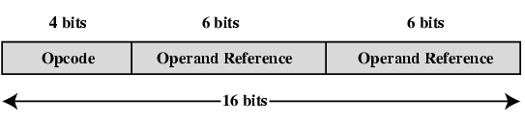
SIMPLE INSTRUCTION FORMAT

Slide 5
INSTRUCTION REPRESENTATION
In machine code each instruction has a unique bit pattern
For human consumption (well, programmers anyway) a symbolic representation is used
  e.g. ADD, SUB, LOAD
Operands can also be represented in this way
  ADD A,B
Notes:
5

Slide 6
INSTRUCTION TYPES
Data processing
Data storage (main memory)
Data movement (I/O)
Program flow control
Notes:
6

Slide 7
I- NUMBER OF ADDRESSES
3 addresses
  Operand 1, Operand 2, Result
  a = b + c;
  May be a forth - next instruction (usually implicit)
  Common in ARM-based architectures
  Needs very long words to hold everything
Notes:
7

Slide 8
II- NUMBER OF ADDRESSES (CONT..)
2 addresses
  One address doubles as operand and result
  a = a + b
  Reduces length of instruction
  Requires some extra work
  Temporary storage to hold some results
Notes:
8

Slide 9
III- NUMBER OF ADDRESSES (CONT..)
1 address
  Implicit second address
  Usually a register (accumulator)
  Common on early machines
Notes:
9

Slide 10
IV-NUMBER OF ADDRESSES (CONT..)
0 (zero) addresses
  All addresses implicit
  Uses a stack
  e.g. push a
  push b
  add
  pop c
  c = a + b
Notes:
10

Slide 11
INSTRUCTION FORMATS
Three-Address Instructions
  ADD R1, R2, R3 R1 ← R2 + R3
Two-Address Instructions
  ADD R1, R2 R1 ← R1 + R2
One-Address Instructions
  ADD M AC ← AC + M[AR]
Zero-Address Instructions
  ADD TOS ← TOS + (TOS – 1)
RISC Instructions
  Lots of registers. Memory is restricted to Load & Store
Instruction
Opcode
Operand(s) or Address(es)

Slide 12
INSTRUCTION FORMATS
Example: Evaluate X= (A+B) ∗ (C+D)
Three-Address
  ADD R1, A, B ; R1 ← M[A] + M[B]
  ADD R2, C, D ; R2 ← M[C] + M[D]
  MUL X, R1, R2 ; M[X] ← R1 ∗ R2

Slide 13
INSTRUCTION FORMATS
Example: Evaluate X =(A+B) ∗ (C+D)
Two-Address
  MOV R1, A ; R1 ← M[A]
  ADD R1, B ; R1 ← R1 + M[B]
  MOV R2, C ; R2 ← M[C]
  ADD R2, D ; R2 ← R2 + M[D]
  MUL R1, R2 ; R1 ← R1 ∗ R2
  MOV X, R1 ; M[X] ← R1
Notes:
MOV R1, A ; R1 ← M[A]
ADD R1, B ; R1 ← R1 + M[B]
MOV R2, C ; R2 ← M[C]
ADD R2, D ; R2 ← R2 + M[D]
MUL R1, R2 ; R1 ← R1 ∗ R2
MOV X, R1 ; M[X] ← R1

Slide 14
INSTRUCTION FORMATS
Example: Evaluate X=(A+B) ∗ (C+D)
One-Address
  LOAD A ; AC ← M[A]
  ADD B ; AC ← AC + M[B]
  STORE T ; M[T] ← AC
  LOAD C ; AC ← M[C]
  ADD D ; AC ← AC + M[D]
  MUL T ; AC ← AC ∗ M[T]
  STORE X ; M[X] ← AC
Notes:
One-Address
LOAD A ; AC ← M[A]
ADD B ; AC ← AC + M[B]
STORE T ; M[T] ← AC
LOAD C ; AC ← M[C]
ADD D ; AC ← AC + M[D]
MUL T ; AC ← AC ∗ M[T]
STORE X ; M[X] ← AC

Slide 15
INSTRUCTION FORMATS
Example: Evaluate X=(A+B) ∗ (C+D)
Zero-Address
  PUSH A ; TOS ← A
  PUSH B ; TOS ← B
  ADD ; TOS ← (A + B)
  PUSH C ; TOS ← C
  PUSH D ; TOS ← D
  ADD ; TOS ← (C + D)
  MUL ; TOS ← (C+D)∗(A+B)
  POP X ; M[X] ← TOS
Notes:
Example: Evaluate X=(A+B) ∗ (C+D)
Zero-Address
PUSH A ; TOS ← A
PUSH B ; TOS ← B
ADD ; TOS ← (A + B)
PUSH C ; TOS ← C
PUSH D ; TOS ← D
ADD ; TOS ← (C + D)
MUL ; TOS ← (C+D)∗(A+B)
POP X ; M[X] ← TOS

Slide 16
INSTRUCTION FORMATS
Example: Evaluate X=(A+B) ∗ (C+D)
RISC
  LOAD R1, A ; R1 ← M[A]
  LOAD R2, B ; R2 ← M[B]
  LOAD R3, C ; R3 ← M[C]
  LOAD R4, D ; R4 ← M[D]
  ADD R1, R1, R2 ; R1 ← R1 + R2
  ADD R3, R3, R4 ; R3 ← R3 + R4
  MUL R1, R1, R3 ; R1 ← R1 ∗ R3
  STORE X, R1 ; M[X] ← R1
Notes:
Example: Evaluate X=(A+B) ∗ (C+D)
RISC
LOAD R1, A ; R1 ← M[A]
LOAD R2, B ; R2 ← M[B]
LOAD R3, C ; R3 ← M[C]
LOAD R4, D ; R4 ← M[D]
ADD R1, R1, R2 ; R1 ← R1 + R2
ADD R3, R3, R4 ; R3 ← R3 + R4
MUL R1, R1, R3 ; R1 ← R1 ∗ R3
STORE X, R1 ; M[X] ← R1

Slide 17
INSTRUCTION FORMATS
Layout of bits in an instruction
Includes opcode
Includes (implicit or explicit) operand(s)
Usually more than one instruction format in an instruction set

Slide 18
INSTRUCTION LENGTH
Affected by and affects:
  Memory size
  Memory organization
  Bus structure
  CPU complexity
  CPU speed
Trade-off between powerful instruction repertoire and saving space
Notes:
Repertoire: How many and which operations to provide and how complex instructions should be

Slide 19
ALLOCATION OF BITS
Number of addressing modes
Number of operands
Register versus memory
Number of register sets
Address range
Address granularity
Notes:
(Reg vs Mem) Single register programming is awkward and requires many instruction. Best is 8-32 reg
(No of Reg) e.g for 2 sets of 8 register, the opcode implicitly will determine which set of registers is being referenced.

Slide 20
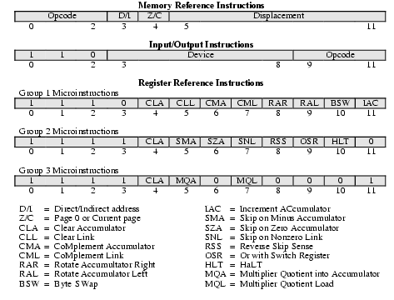
PDP-8 INSTRUCTION FORMAT
Notes:
PDP-Program Data Processor
Memory is divided into fixed length pages 2^7=128 words each. Address can be based on ref from page 0 or current page.

Slide 21
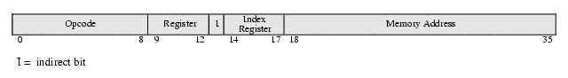
PDP-10 INSTRUCTION FORMAT
Orthogonality
  Address computed in the same way regardless of opcode
Completeness
  Each data type have complete and identical instructions
Direct Addressing

Slide 22
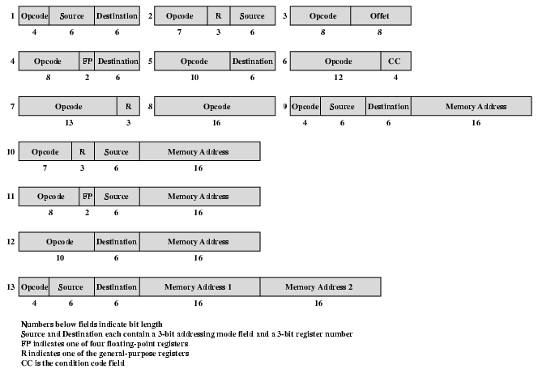
PDP-11 INSTRUCTION FORMAT – VARIABLE LENGTH

Slide 23
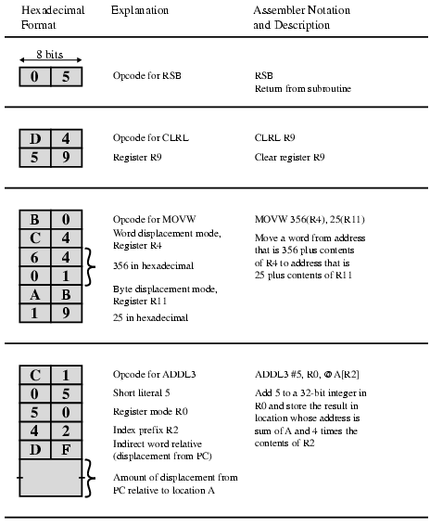
VAX INSTRUCTION EXAMPLES
Notes:
Highly variable. Variable OpCode length starting from 1 byte. Instructions lengths 1 – 37 Bytes. Can have up to 6 operands

Slide 24
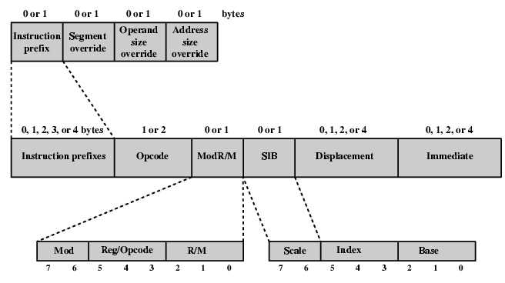
PENTIUM INSTRUCTION FORMAT
Notes:
ModR/M – if in reg or mem. Addressing mode if in mem.
Addressing mode part of opcode sequence rather than with each operand. Therefore, only one mem operand possible. Unlike VAX.

Slide 25
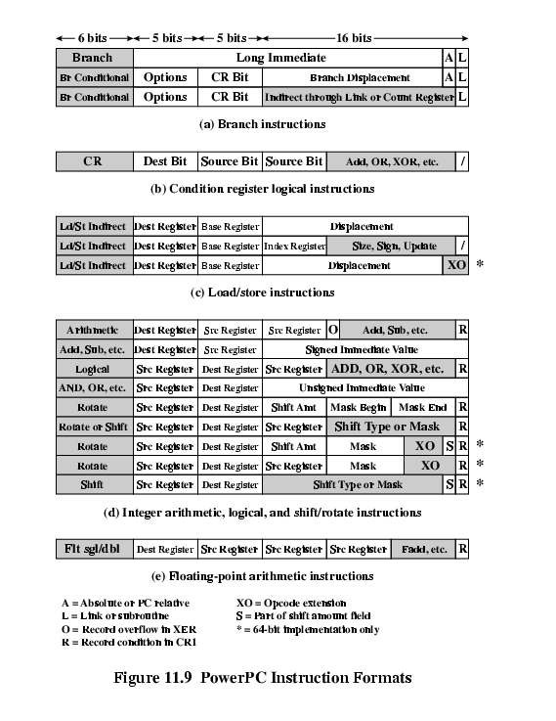
POWERPC INSTRUCTION FORMATS (1)

Slide 26
POWERPC INSTRUCTION FORMATS (2)

Slide 27
FOREGROUND READING
William Stallings
Chapter 10
  Section 10.1
Chapter 11
  Section 11.3
8th Edition
Intel and PowerPC Web sites

